Slide 1

2019 REGIONAL CONFERENCES

Slide 2

DEPARTMENT OF FINANCE AND ADMINISTRATION

Slide 3

Department of Finance and Administration
National
President
DIRECTOR
FINANCE OFFICER
ADMINISTRATIVE
ASSISTANT

Slide 4

2018 Financial Results

Slide 5
Revenues
Membership Dues
Rebates to locals
Interest
Miscellaneous Income

Slide 6
Expenses
National Office
Committees
National Executive
Events and Training

Slide 7
Contingencies
This section includes all additional spending over budget approved by the National executive to be spent from reserves.
Donations
Committees
Events
New in 2018 – Strategic Plan!

Slide 8
Contacting USJE Finance
USJEFinanceSESJ@psac-afpc.com

Slide 9
DEPARTMENT OF POLICY, PROJECTS
AND MEDIA RELATIONS

Slide 10
Department of Policy, Projects and Media Relations
National
President
DIRECTOR
ASSOCIATE DIRECTOR
EXECUTIVE ASSISTANT TO THE NATIONAL
PRESIDENT
STRATEGIC
COMMUNICATIONS
SPECIALIST
RESEARCHER
COMMUNICATIONS
ASSISTANT

Slide 11
Objectives
Our members are aware of USJE
Appreciate the services we provide

Slide 12
Objectives
Appreciate the services we provide
Become involved in their union
Our members are aware of USJE

Slide 13
Objectives
Appreciate the services we provide
Become involved in their union
Are proud to be a union member
Our members are aware of USJE

Slide 14

Objectives
Appreciate the services we provide
Become involved in their union
Are proud to be a union member
Our members are aware of USJE
Key decision-makers know USJE and our work
Make decisions that …

Slide 15
Objectives
Appreciate the services we provide
Become involved in their union
Are proud to be a union member
Our members are aware of USJE
Key decision-makers know USJE and our work
Make decisions that …
improve the professional and
economic lives of our members

Slide 16

POLICY
Ensuring key decision-makers are aware of key issues for our USJE members through:
Meetings – Commissioners, Bureaucrats, MPs, Ministers

Slide 17
POLICY
Ensuring key decision-makers are aware of key issues for our USJE members through:
Meetings – Commissioners, Bureaucrats, MPs
Parliamentary Committees – C-65 Harassment & C-83 Admin Seg

Slide 18
POLICY
Ensuring key decision-makers are aware of key issues for our USJE members through:
Meetings
Parliamentary Committees – C-65 Harassment & C-83 Admin Seg
Opinion Pieces

Slide 19
POLICY
Ensuring key decision-makers are aware of key issues for our USJE members through:
Meetings
Parliamentary Committees – C-65 Harassment & C-83 Admin Seg
Opinion Pieces
Research

Slide 20
POLICY
Ensuring key decision-makers are aware of key issues for our USJE members through:
Meetings
Parliamentary Committees – C-65 Harassment & C-83 Admin Seg
Opinion Pieces
Research
Participation in Federal Election

Slide 21
Key Policy Topics for USJE
Harassment

Slide 22
Key Policy Topics for USJE
Mental Health –
Operational Stress Injuries
Harassment

Slide 23
Key Policy Topics for USJE
Mental Health –
Operational Stress Injuries
Harassment
Engagement with Indigenous Members/Initiatives/
Programs

Slide 24
Key Policy Topics for USJE
Mental Health –
Operational Stress Injuries
Harassment
Engagement with Indigenous Members/Initiatives/Programs
Community Involvement

Slide 25
PROJECTS
Ensuring our members are aware of USJE through:
Our New Member Handbook

Slide 26


Our New Member Handbook!

Slide 27

Our New Member Postcard!

Slide 28
Our New Member Handbook!
4,000 members

Slide 29
Our New Member Handbook!
4,000 members
have not signed their cards.

Slide 30
Our New Member Handbook!
9,000 members

Slide 31
Our New Member Handbook!
9,000 members
have not given us
their personal email addresses.

Slide 32
Our New Member Handbook!
The Handbook is a tool to:

Slide 33
Our New Member Handbook!
The Handbook is a tool to:
        educate

Slide 34
Our New Member Handbook!
The Handbook is a tool to:
        educate
        get signed membership cards

Slide 35
Our New Member Handbook!
The Handbook is a tool to:
        educate
        get signed membership cards
        get personal email addresses

Slide 36
Our New Member Handbook!
National Launch Date

Slide 37
Our New Member Handbook!
National Launch Date
Monday June 10, 2019

Slide 38
Our New Member Handbook!
National Launch Date
Monday June 10, 2019
Sign up for the numbers you would like!

Slide 39
PROJECTS
Ensuring our members are aware of USJE through:
Our New Member Handbook
Website

Slide 40
Sign up for Alerts!
Sign up for alerts!
----------
Write articles!
----------
Share info with members!
usje-sesj.com

Slide 41
PROJECTS
Ensuring our members are aware of USJE through:
Our New Member Handbook
Website
Social Media

Slide 42
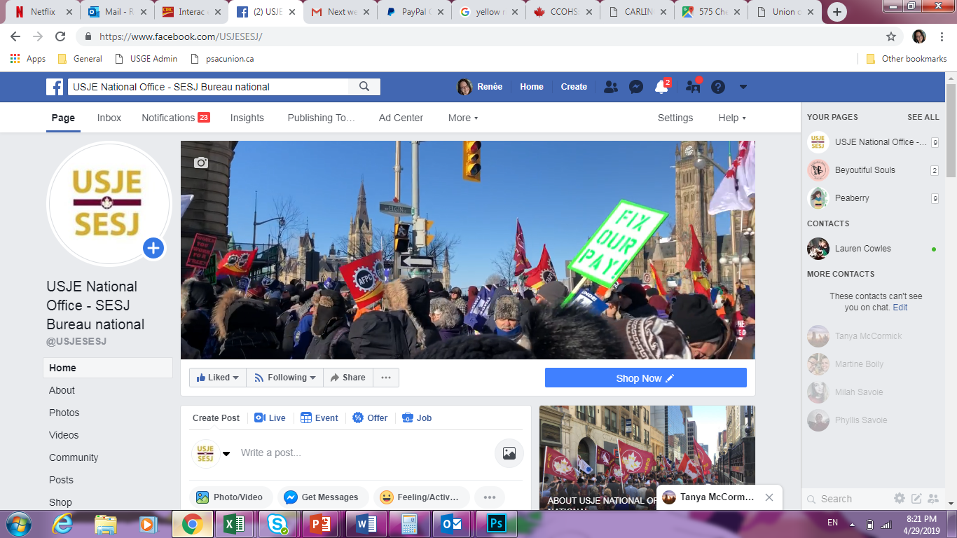
Like us on Facebook!
Find our page
@ USJESESJ
Share your USJE photos with us!

Slide 43
PROJECTS
Ensuring our members are aware of USJE through:
Our New Member Handbook
Website
Social Media
Videos

Slide 44




Award-winning Videos!
Our latest videos
----------
Animated shorts
----------
Illuminating Safety
USJE / SESJ

Slide 45
PROJECTS
Ensuring our members are aware of USJE through:
Our New Member Handbook
Website
Social Media
Videos
Direct Messaging to Members – New Newsletter!

Slide 46
The 2018 survey of members showed that
members overwhelming want information
by…

Slide 47
The 2018 survey of members showed that
members overwhelming want information
by e-mail.

Slide 48

Read our Newsletter!
The 2018 survey of members showed that
members want information by email.
This led to:
Our new USJE newsletter!

Slide 49


Direct messages to members
USJE Newsletter
New Member Handbook
Harassment Survey
Federal Election
Videos
Website Updates - Convention logo competition

Slide 50


MEDIA
Proactive:
Opinion pieces
Panel participation
Reactive:
If you are approached, ask for a minute and contact your RVP or US!

Slide 51
More Information Required?
If you need more information:
Contact your RVP
If your RVP is not available:
Speak to a member of our department!
Our contact information is at: www.usje-sesj.com

Slide 52



Stay Connected
How to find us:
FACEBOOK
@USJESESJ
TWITTER
@usje_sesj
WEBSITE
usje-sesj.com
YOUTUBE
USJE/SESJ
EMAIL
USJEcommunicationSESJ@psac-afpc.com

Slide 53
2019 REGIONAL CONFERENCES

