Slide 1
How to influence the upcoming federal election
Union of Safety and Justice Employees

Slide 2
Themes to address today
  Overview of the federal politcal landscape
  Best practices of national not-for-profit organizations that have influenced election platforms of all parties
  CASE STUDY of the Canadian Housing and Renewal Association/

Slide 3
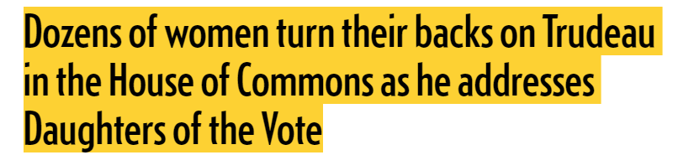
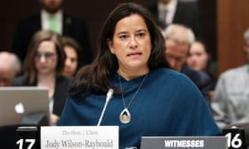

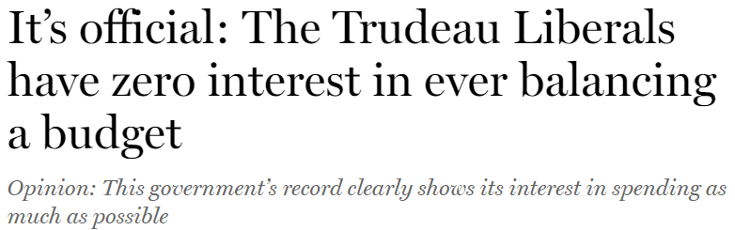
Aperçu du contexte fédéral actuel
Les tensions entre les partis politiques sont extrêmement hautes.
Notes:
Perturbations dans la Chambre des communes de la part des Conservateurs lors du depot du budget federal.
Jeux politiques avec les jeunes femmes déléguées des Héritières du suffrage.
Trudeau menace Scheer d’une poursuite relié

Slide 4
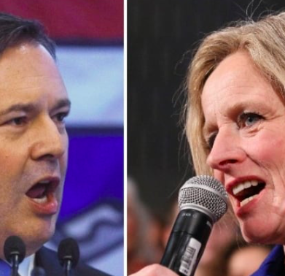
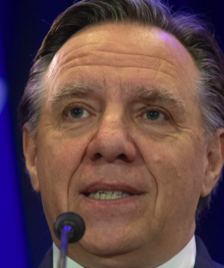
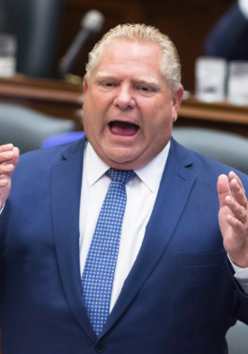
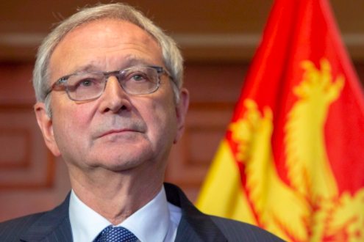
Aperçu du contexte fédéral actuel
Recent elections in BC & Alberta, Quebec, PEI & NL will have an impact on the federal election outcome…
we just don’t know how!

Slide 5
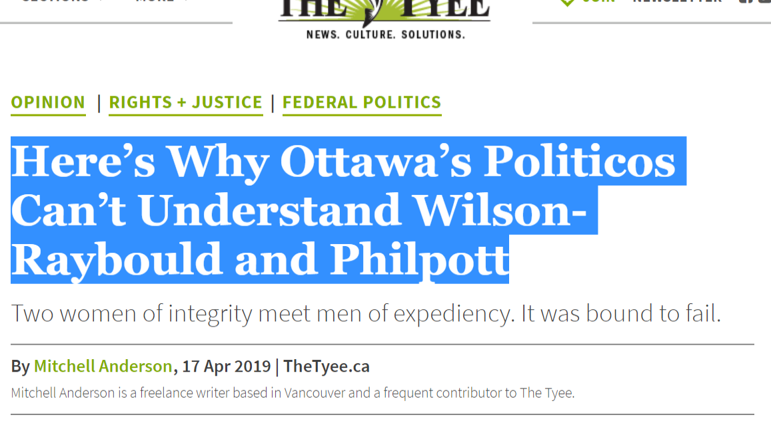


OVERVIEW OF FEDERAL POLITICAL CONTEXT
Crises putting into question the following Liberal values:
Reconciliation
Investment in social causes
Broken promises on electoral reform
Climate change

Slide 6
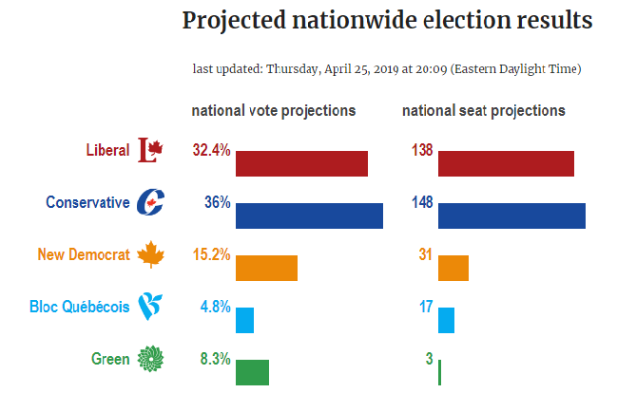
RECENT POLLING DATA
Résultats projetés par CalculatedPolitics.com – 25 avril 2019

Slide 7
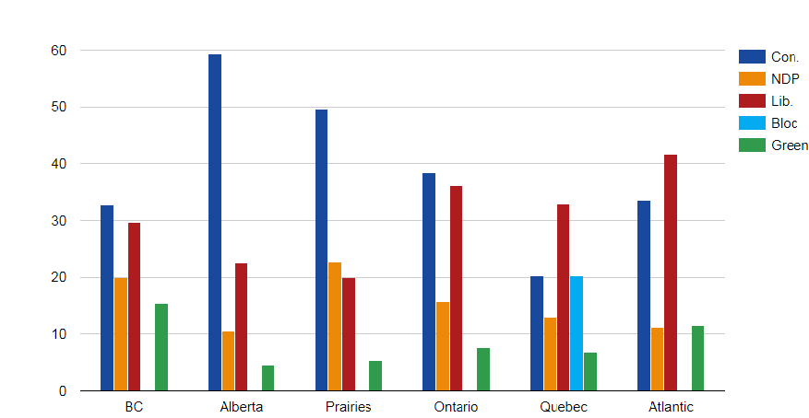
How Canadians could vote (IF ELECTION WAS NOW)
Résultats projetés par CalculatedPolitics.com – 25 avril 2019

Slide 8
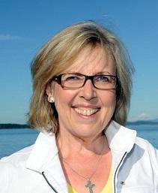
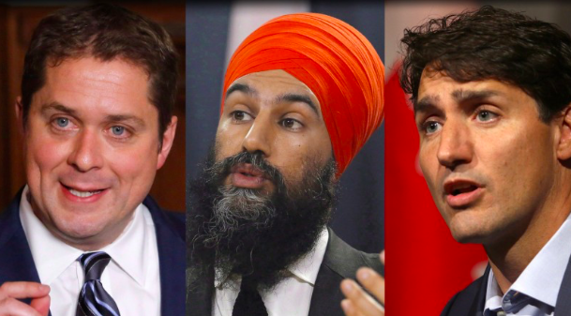
PARTIES RECRUITING FEDERAL candidates
Confirmed Candidates
226 CPC
169 LPC/Libéraux
88 Greens/Verts
58 NDP/NPD
15 BQ (max 77)

Slide 9
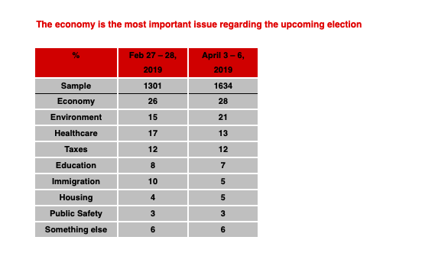
Aperçu du contexte fédéral actuel
Sondage le plus récent decA
Canada-wide poll sample of issues of concern to voters:
42% Conservateurs
29% Libéraux
12 % NPD

Slide 10
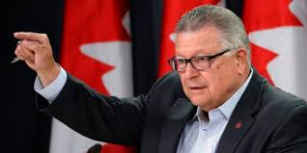
FEDERAL Public safety CLIMATE
PRIORITIES (Minister Goodale’s 2015 Mandate letter):
Anti-terrorism/Counter-radicalization efforts
Critical infrastructure and cyber-threats
Coordinated national action plan on post-traumatic stress disorder
Nation-wide plans for weather-related emergencies and natural disasters
Curb harassment within RCMP and federally regulated workplaces
Address gaps for indigenous peoples & those with mental health challenges throughout federal correctional system

Slide 11
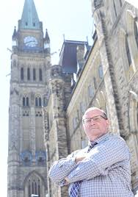
USJE LANDSCAPE
OUR FOCUS
Commissioned groundbreaking Occupational Stress Injury Report focused on direct & vicarious trauma across USJE membership (2017)
2. Co-led a unique & joint RCMP-USJE investigation into an incident of harassment in Division C (2017)
Launched federal Parole officer survey (2018) with a plan to release by end of June 2019

Slide 12

USJE LANDSCAPE
OUR FOCUS
4. Convened historic USJE led indigenous roundtable within Corrections (2018)
5. Hosted two key USJE focused dialogues with RCMP Commissioner & Minister of Public Safety Ralph Goodale (2019) + 3rd one in the fall
6. Legislation overhauling admin segregation (solitary confinement)
7. Launched a survey on workplace bullying & harassment

Slide 13

What’s usje’s story?
What’s our story?
A federal public service union of 16,000 people across 18 federal departments keeping Canadians safe
USJE members are “Keepers” of public safety but we often function in the shadows of 1st responders, Correctional guards, judges/lawyers…. Play supporting and-or key roles in the cast
The task of keeping Canadians safe is fraught with challenges and our members are not always supported on the job

Slide 14
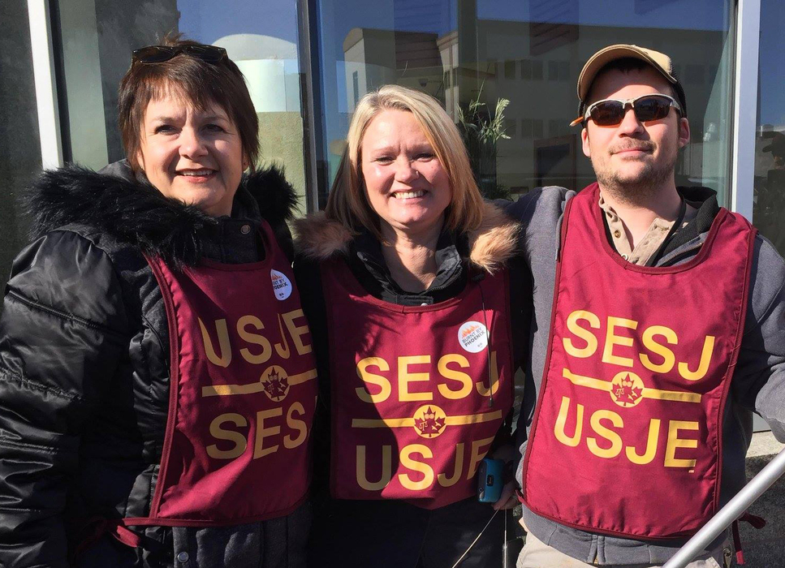
Challenges in telling our story
We have got a lot of stories to tell!
Many of our people are truly ‘behind the scenes’
Our members do not always enjoy the status that other high ranking employees hold within the public service or federal agencies (RCMP, CSC, Public Prosecutions, Tribunals)
USJE is still a small fish in a big pond in political Ottawa / USJE’s brand is relatively new
The landscape within departments/agencies is changing rapidly

Slide 15
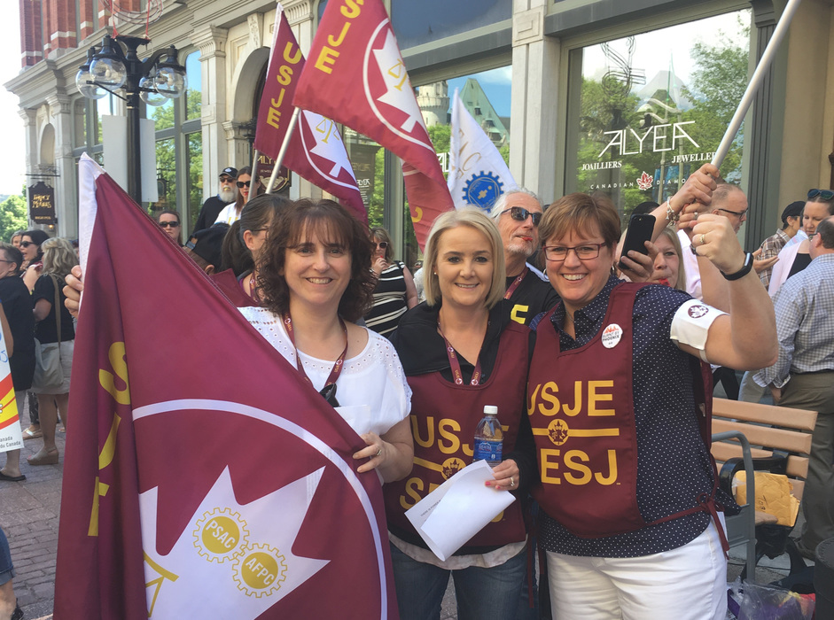
Good news about our story
We have GREAT STORIES to tell!
There is a lot at stake when it comes to public safety…easy to hook people.
Canadians care about fairness, and good government
Many of our issues transcend typical party lines
The landscape within departments/agencies is changing rapidly

Slide 16
What is our compelling drama?
Three Major Themes (3Rs)?:
Our members:
Enable a quick & robust response to community safety challenges & crises (RCMP, CSC, more)
We retain and restore public safety & criminal justice infrastructure, from police, to courts to prisons to oversight bodies (Public prosecutions, tribunals, information security, civilian oversight)
Actively manage risk & support redemption/rehabilitation of incarcerated individuals caught in criminal justice system

Slide 17

Converting asks into wins
USJE has primarily focused on:
1. More/different financial investments in departments/agencies to ensure there are sufficient human resources/systems so that our members can do their work well
2. Better management approaches that recognize the unique & invaluable role our members play
3. Improved training & protocols on harassment/bulling/prevention of occupation stress injuries/organizational culture

Slide 18

What are usje’s top 3 pre-election asks?
1. EXAMPLE - Double current investment in rehabilitative staff and apprenticeship opportunities in federal Corrections (assign dollar amount) – institution and community
2.
3.

Slide 19
4 questions that the media will ask about the issue?
What is at stake right now?
Is there a new development or is this recycled news?
How will this issue affect the daily life of my readers/viewers?
What personal stories can I attached to this?
Notes:
Une demande claire et bien réfléchie – et non une liste d’épicerie.
Une campagne à multiples volets : relations medias, medias sociaux, relations governementales, publicités, partenariats – avec accent sur des activités sur le terrain partout au pays.
Une solution positionée afin d’etre enlignée avec les priorités du gouvernement et des partis. (150 M $ pour Voix et leadership des femmes)
Stratégie et équipe d’éxécution souple. Le plan va changer, c’est certain !
Vision macro – une parmi 70 000 associations au Canada.
Engagement soutenu de la part de tous ses members à travers le Canada.

Slide 20
Understanding wHat the politicians need in evaluating an issue?
  How much will this proposal cost taxpayers?
  How will this issue impact the votes I need to win?
  What is the local impact in my riding?
Notes:
Une demande claire et bien réfléchie – et non une liste d’épicerie.
Une campagne à multiples volets : relations medias, medias sociaux, relations governementales, publicités, partenariats – avec accent sur des activités sur le terrain partout au pays.
Une solution positionée afin d’etre enlignée avec les priorités du gouvernement et des partis. (150 M $ pour Voix et leadership des femmes)
Stratégie et équipe d’éxécution souple. Le plan va changer, c’est certain !
Vision macro – une parmi 70 000 associations au Canada.
Engagement soutenu de la part de tous ses members à travers le Canada.

Slide 21

Case study:
Affordable housing for everyone (2015)
The Canadian Housing Renewal Association sought
to make affordable housing a major issue in the federal election in 2015
Notes:
Très peu d’investissement dans le logement social et abordable au cours des derniers 30 ans.
Crise de logement abordable dans plusieurs villes et longue liste d’attente pour un logement social.
Enjeu compliqué à expliquer et donc peu de traction médiatique et d’engagement de la part des élu(e)s

Slide 22
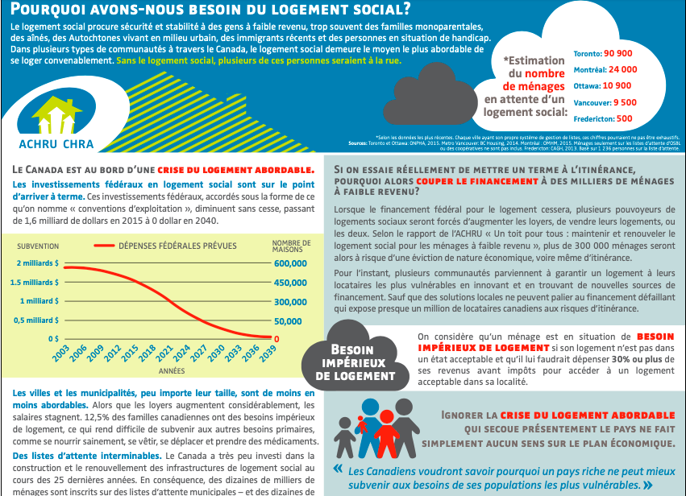
Case stody: Housing for everyone
At stake:
Very little invesment in social or affordable housing in nearly 30 years.
Housing crises in many communities and long wait lists in social housing
A complex policy issue with little media traction and almost no engagement from politicians

Slide 23
How CHRA changed the game in the fed election
A clear, well-conceived ask, not a shopping list.
A campaign with multiple components:
  Media relations
  Social media
  Government relations
  Strategic public engagement
  Partners
  Grassroots activities on the ground
Notes:
Une demande claire et bien réfléchie – et non une liste d’épicerie.
Une campagne à multiples volets : relations medias, medias sociaux, relations governementales, publicités, partenariats – avec accent sur des activités sur le terrain partout au pays.
Une solution positionée afin d’etre enlignée avec les priorités du gouvernement et des partis. (150 M $ pour Voix et leadership des femmes)
Stratégie et équipe d’éxécution souple. Le plan va changer, c’est certain !
Vision macro – une parmi 70 000 associations au Canada.
Engagement soutenu de la part de tous ses members à travers le Canada.

Slide 24
Best practices
3. A positive solution which was aligned with the priorities of some/most parties;
4. A focused strategy that was nimble but could be executed. The plan changed more than once!
5. A big picture view that was inclusive of all interests
6. Grassroots engagement from members on the ground from coast to coast.
Notes:
Une demande claire et bien réfléchie – et non une liste d’épicerie.
Une campagne à multiples volets : relations medias, medias sociaux, relations governementales, publicités, partenariats – avec accent sur des activités sur le terrain partout au pays.
Une solution positionée afin d’etre enlignée avec les priorités du gouvernement et des partis. (150 M $ pour Voix et leadership des femmes)
Stratégie et équipe d’éxécution souple. Le plan va changer, c’est certain !
Vision macro – une parmi 70 000 associations au Canada.
Engagement soutenu de la part de tous ses members à travers le Canada.

Slide 25







1. Partners

Slide 26

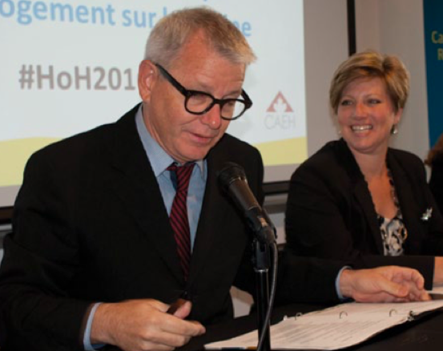
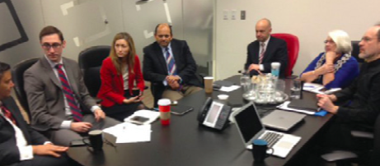

Étude decas : un logement pour tous (2015)
  2. Strategic engagement of elected officials and candidates:
  Coordination of 10 regional roundtable across the country (less than 25 people at each one!).
  Conversations were supported with CHRA reps/current MP and/or critics who had developed insight/expertise in affordable housing

Slide 27

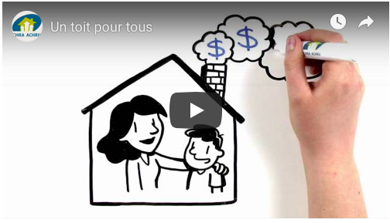
Étude de cas : un logement pour tous (2015)
3. Marketing focused on both the problem and its solution and was targeted to media, candidates/elected officials and the public
    Micro-site
    Short explanatory video (illustrations)
    On line tools: sample letters, logos and graphoc design to share over social media
Vidéo (Youtube)

Slide 28

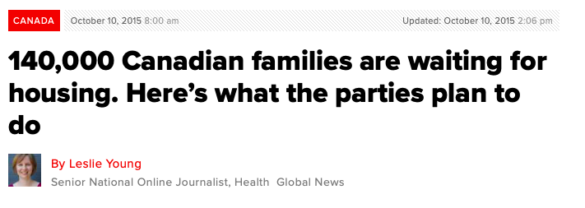

Étude de cas : un logement pour tous (2015)
Journalists were identified from a variety of publications who were likely to write about the story
5. Members were kept up to date through a regular info-letter which highlighted successes on the ground

Slide 29


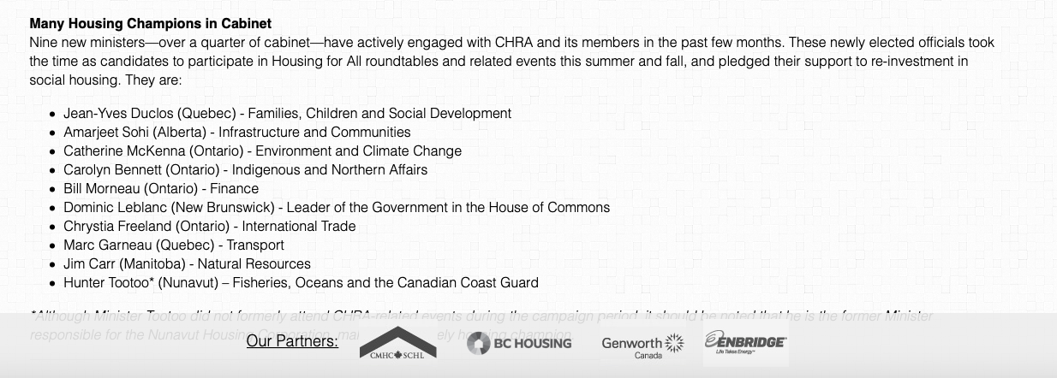
Case study= Housing for all
RESULTS:
Allies were secured who won the election and serve in positions of power
Affordable housing was featured in the mandate letter of several Ministers
A national housing strategy became a priority for the new government
New investment of $40 billion (?)
10 nouveaux ministres avaient participé aux tables rondes de l’ACHRU comme candidats.

Slide 30
ÉtudWie de caWios : un logement pour tousWin W(2015)
Winning Approach:
National efforts combined with local teamwork
Flexible plan focused on a clear goal, with many course corrections along the way
Consultation about the need with emphasis on desired outcome
Small collaborative team dedicated to the cause
Patience and generous spirit

