Slide 1

Union of Safety and Justice Employees
May 30th, 2018

Slide 2
The Joint Learning Program
Mission: To improve workplace relations and deepen understanding of the roles of the union and the employer.
Offer Learning activities (workshops) on seven topics:
Creating a Harassment-Free Workplace
Employment Equity
Duty to Accommodate
Mental Health in the Workplace
Labour-Management Consultation
Respecting Differences/Anti-Discrimination
Understanding the Collective Agreement
Notes:
Pilot project was a success resulting in 600 learning events reaching approximately 15 000 participants.

Slide 3
Our Approach
A Partnership Model
• Co-development of learning material
• Joint request to host workshops
• Co-delivery of workshops
• Joint audience
Experiential Learning Approach
Learning by participating in discussions
Fostering reflection, dialogue, problem solving and application of ideas and skills to workplace situations
Discussing relevant and sensitive topics in an egalitarian learning environment that fosters respect amongst each other

Slide 4
Request Based Workshops
To host a JLP workshop
submit an online union-management joint request for one of the seven topics
Organizers have access to a small budget to assist with the logistics
Workshops are limited to between 15 and 20 participants.
Request for several workshops by one department
would be considered under a strategic partnership.

Slide 5
Peer Facilitation
“Volunteer” peer facilitation model is at the very heart of the JLP and it increases credibility and ownership.
To become a facilitator:
Submit an application with the support of your manager and union representative (for union facilitators).
Attend a one-week training session, we provide materials to assist new facilitators learn about the issues of the workshop.
Learn new transferable skills, effective communication, team work, conflict resolution, which enhances professional life.
Notes:
The Program uses a volunteer peer facilitation model- and these volunteer are at the very heart of the JLP. These people are trained by the JLP to become facilitator – not instructor or teacher. They have good understanding of the issues the workshop addresses but they are not subject matter expert. They are leaders who guide participants through exercise that foster reflection, dialogue, problem solving.
All facilitators in the JLP are supported by their manager to participate in a 5 days train the trainer training and to prepare/deliver a minimum of 5 workshops following their training since their salary is paid by their home department. Other expenses are covered by the JLP. There is an additional requirement for FAC that delivers MHW to have successfully completed the mental health first aid training offered by the Mental health Commission.
We have pool of over 630 facilitators across the country and one of the reason that it is support it’s because of the transferable skills that are applicable to the day to day job in the departments such as team work, conflict resolution. Moreover, these individuals individual share the values and belief

Slide 6
Mental Health in the Workplace (MHW)
Released in June 2015.
Over 40% of the JLP’s requested workshops.

Slide 7
Mental Health Commission of Canada
Mental Health
Did you know?
1 in 5 people in Canada live with mental health problems each year.
1 in 3 Canadians will experience a mental health problem in their lifetime.

Slide 8
Stongly Disagree (1)
1…..to…..10
Stongly Agree (10)

Slide 9
The topic of mental health has become increasingly apparent in my work life.
I am very comfortable talking about mental health issues with other at work
I feel able to support my colleagues who are experiencing mental health problems

Slide 10
Mental Health:
is a state of well-being in which an individual realizes his or her own abilities, can cope with the normal stresses of life, can work productively and is able to make a contribution to his or her community. In this positive sense, mental health is the foundation for individual well-being and the effective functioning of a community.
World Health Organization

Slide 11
Mental Health Problem:
is a broader term that includes both mental disorders and symptoms of mental disorders which may not be severe enough to warrant the diagnosis of a mental disorder.
The term mental health problems…represent the range of problems. Even a mental health problem can cause major changes in a person’s thinking, emotional state and behaviour, and can disrupt the person’s ability to work and carry on their usual personal relationships. It is important to recognize that with most mental health problems, the symptoms are not static and can improve or worsen over time.
Mental Health First Aid Canada

Slide 12
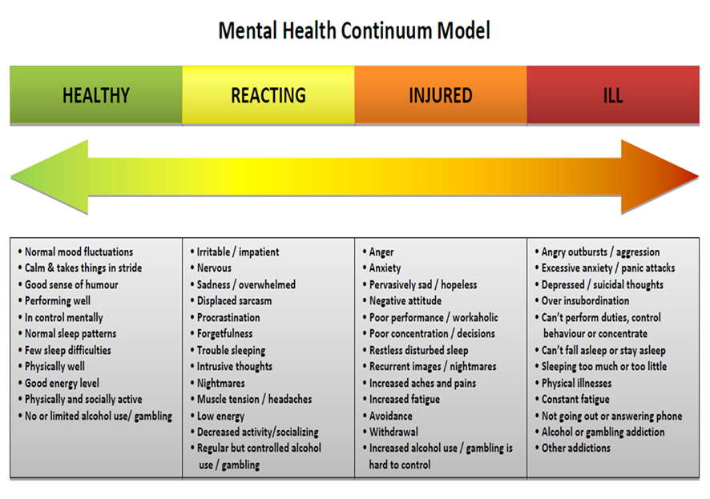

Slide 13
Stigma
There is stigma associated with mental health problems
Imagine if we treated everyone like we treat people with mental illness.

Slide 14

Struck Down

Slide 15
Stigma
Stigma can be translated into discrimination.
Often stigma is what keeps people from seeking treatment.
Some have described stigma and discrimination as more debilitating then the illness itself.

Slide 16
Stigma: Table Discussion
How does this match your experience in the ways you have heard people with mental health problems described?
What does this video tell you about different ways society views physical injuries and mental injuries?

Slide 17
Psychological Health and Safety:
is about safeguarding the psychological health of employees. A psychologically healthy and safe workplace is one that promotes employees’ psychological well-being and actively works to prevent harm to employee psychological health due to negligent, reckless or intentional acts.
Guarding Minds@Work

Slide 18
Psychological Health and Safety: Table Discussion
What would a psychologically healthy and safe workplace look like?

Slide 19
Psychological Health and Safety:
Welcoming environment
Employees are interacting with one another
There is smiling and laughter
Employees socialize at lunch and share events together (i.e. birthdays)
Employees are engaged in their work and moral is good
Communication is open and conflict is resolved productively
There is equality and respect
There is mutual support and the environment is non-competitive
The organization has a clear mission statement and the employees are committed to it

Slide 20
Psychological Health and Safety:
Sounds great…..but how do we achieve this?

Slide 21
National Standard of Canada for Psychological Health and Safety in the Workplace
Developed by the Canadian Standards Association and the Bureau de normalisation du Québec
The Standard was launched in January 2013
Voluntary and intended to help promote mental health in the workplace and to prevent harm for all employees

Slide 22
13 Workplace Factors for a Psychologically Healthy and Safe Workplace
1. Psychological Support
2. Organizational Culture
Clear Leadership &
Expectations
4. Civility and Respect
5. Psychological Demands
6. Growth & Development
7. Recognition and Reward
8. Involvement & Influence
9. Workload Management
10. Engagement
11. Balance
12. Psychological Protection
Protection of Physical
Safety

Slide 23
13 Workplace Factors:
Table Discussion
Which workplace factors are a priority for your members and their workplaces?
What steps can you take to support your Locals to bring these factors to life in the workplace?

Slide 24
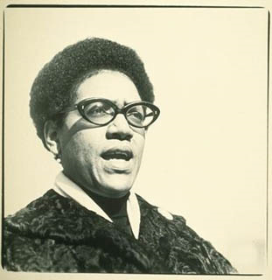
“Caring for myself is not self-indulgence, it is self-preservation, and that is an act of political warfare.”
Audre Lorde

Slide 25
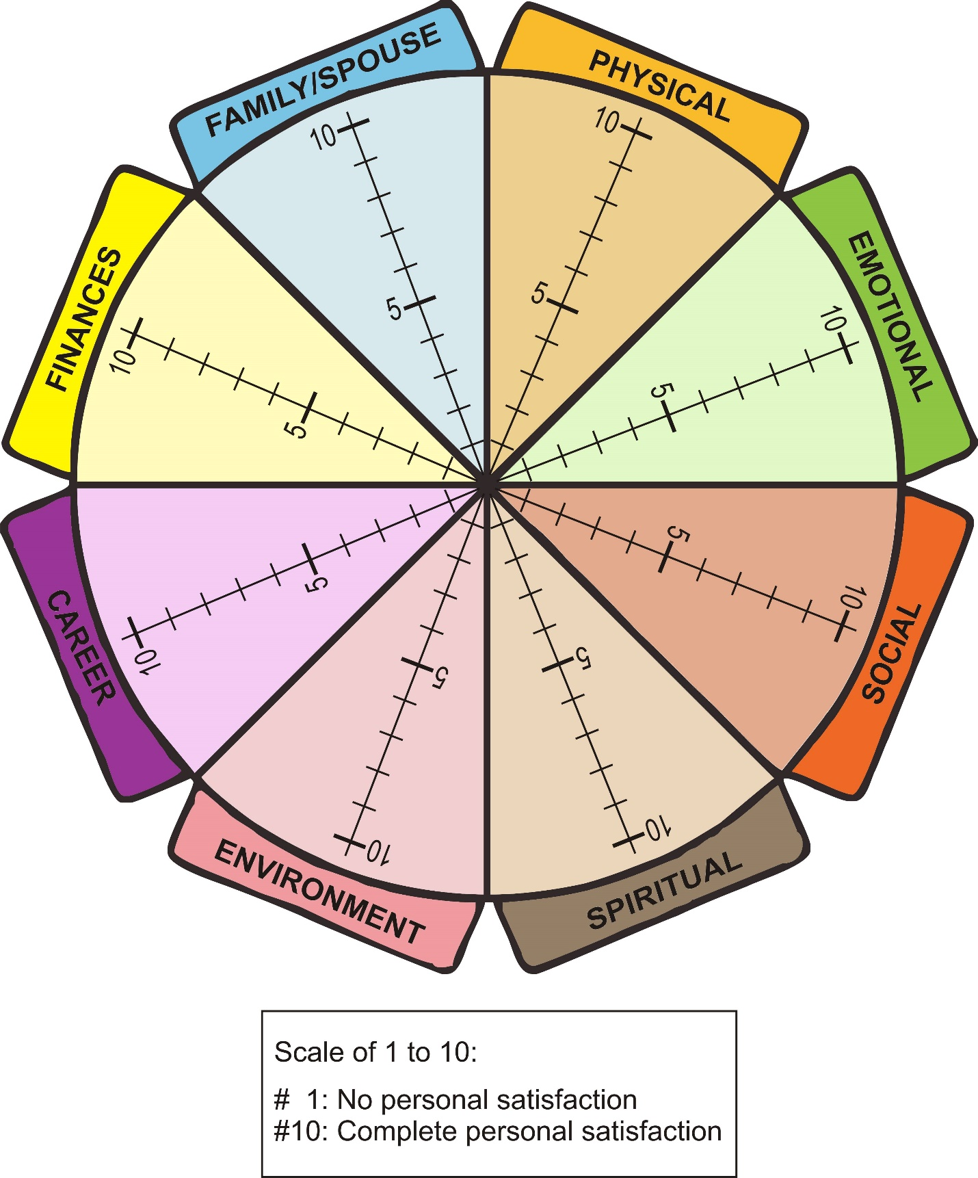
The Wellness Wheel

Slide 26
Thank you!
Rachel Besharah
besharr@psac-afpc.com
Nathalie Duquette
duquetn@psac-afpc.com
www.jlp-pam.ca

