Slide 1
Union of Safety and Justice Employees
NATIONAL LOCAL
PRESIDENTS MEETING
2018
May 29-30 Gatineau, QC

Slide 2

NATIONAL OFFICE
NATIONAL PRESIDENT
Director of Finance and Administration
Administrative Assistant
Mail Distribution Clerk/Receptionist
Director of Labour Relations
Head of Information Management
Case Management Assistants (x2)
Director of Policy, Projects and Media Relations
Finance Officer
Executive Assistant to the National President
Labour Relations Officers (x3)
Senior Advisor to the Director of Policy, Projects and Media Relations
Researcher
Strategic Communications Specialist
Organizational Structure

Slide 3
Department of Labour Relations and Information Management

Slide 4
Department of Labour Relations
NATIONAL PRESIDENT
Director
Labour Relations Officer
Head of Information Management
Case Management Assistant
Executive Assistant to the National President
Labour Relations Officer
Labour Relations Officer
Case Management Assistant

Slide 5
Role of Director of Labour Relations
Director
Assist and advise National President and National Executive on Labour Relations matters
Oversee Labour Relations Officers
Oversee Information Management team

Slide 6
Role of Labour Relations Officers
General
Represent members at the third level of the grievance procedure
Assist and advise RVPs on labour relations matters
Create and provide directed training to our members

Slide 7
USJE’s Labour Relations Officers
Jean-Yves Lebel
Denyse Saumur
Dominique Vidmar
Manitoba
Saskatchewan
Alberta
British Columbia
The North
Job description and acting pay grievances
National Capital Region
Ontario (except National Capital Region)
Quebec
Atlantic

Slide 8
Role of the Information Management Team
General
Maintain records of grievances that are sent to the National Office
Maintain membership records
Work with members and Employer representatives to ensure proper record keeping

Slide 9
Information Management
Notes:
Hello everyone!

Slide 10
Grievances
Notes:
Hello everyone!

Slide 11
Information Management - Grievances
Information Management Role in the Grievance process
Grievance Inbox
USJEgrievance_griefSESJ@psac-afpc.com
Notification of Third Level Grievances
File Requests
- Job Description
      - Other Grievances
Complete Files/Forms
Notes:
In this short grievance section of the presentation we will review what our role is at USJE with respect to grievances and how it relates to you as a Local President.

Slide 12
Information Management
Role in the Grievance Process

Slide 13
Role in the Grievance Process
Responsible for the administration of all new grievances at the third level of the grievance process (with the exception of Classification grievances).
We are made aware of and track grievances once they have reached the third level of the grievance process.
Once entered into our database (UnionWare) and all initial documentation has been received, files are assigned to a Labour Relations Officer based on their portfolios.
Notes:
Information Management is responsible for administering all new grievance files at the third level. It is important to remember that we only receive and know about third level grievances. We do not have access to, nor do we have any knowledge of grievances at the lower levels. Once a grievance has been opened in UnionWare and initial documentation has been received, they are assigned to a Labour Relations Officer based on their portfolios.

Slide 14
Information Management
Grievance Inbox

Slide 15
Grievance Inbox
We have a dedicated inbox for grievances:
USJEgrievance_griefSESJ@psac-afpc.com
USJE is a paperless office, as such, grievances must be submitted to the National Office via the grievance inbox.
RVPs are responsible for forwarding grievance files to the National Office.
Notes:
We have a dedicated inbox for grievances USJEgrievance_griefSESJ@psac-afpc.com. USJE is a paperless office, as such, grievances must be submitted to the National Office via the grievance inbox. Regional Vice-Presidents (RVP)s are responsible for reviewing and forwarding complete third level grievances to the inbox.

Slide 16
Information Management
How the USJE National Office is Notified of Grievances at the Third Level

Slide 17
Notification of Third Level Grievances
RVP forwards the grievance to the grievance inbox.
Labour Relations Officer is contacted by the department to schedule a third level hearing.
Acknowledgement has been sent to us by the department (CSC).
Notes:
The usual way in which we are notified of a third level grievance is by the RVP forwarding the file to the grievance inbox. Second, is if a department has contacted a USJE Labour Relations Officer (LRO) to schedule a hearing and the grievance is not already in our database (UnionWare). The third is by receiving an acknowledgment from the department that the grievance has been transmitted to the third level. At present, Correctional Service Canada (CSC) is the only department that provides us with formal acknowledgments.

Slide 18
Information Management
File Requests - Job Description

Slide 19
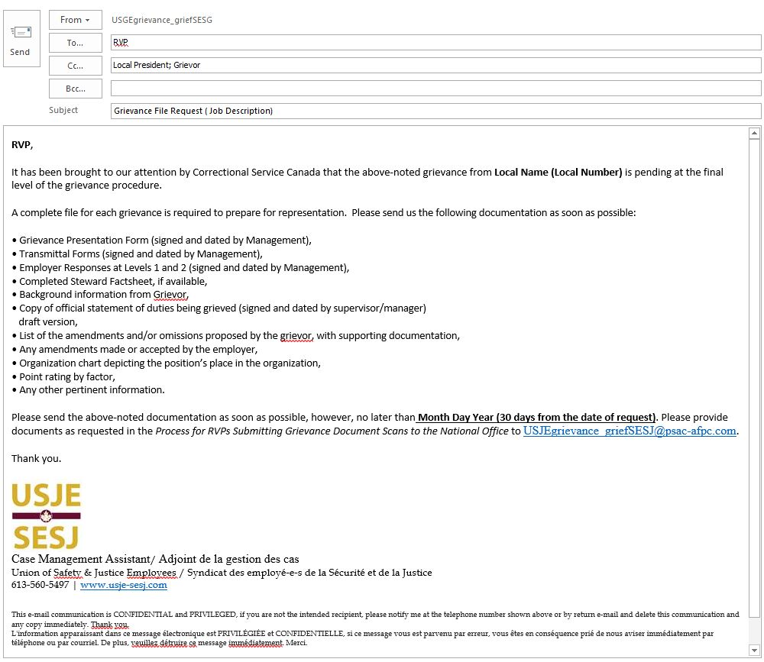
Notes:
If an LRO advises us of a grievance that is not in UnionWare or when an acknowledgement is received, we send out a file request to the responsible RVP with a copy to the grievor and the Local President. Local Presidents are copied on the file request to ensure that all relevant documentation has be forwarded to the RVP.
This is an example of the request for a job description grievance. Job description grievances require specific supporting documents which would likely be irrelevant to other types of grievances, as such, we have a customized file request.

Slide 20
Information Management
File Requests - Other Grievances

Slide 21
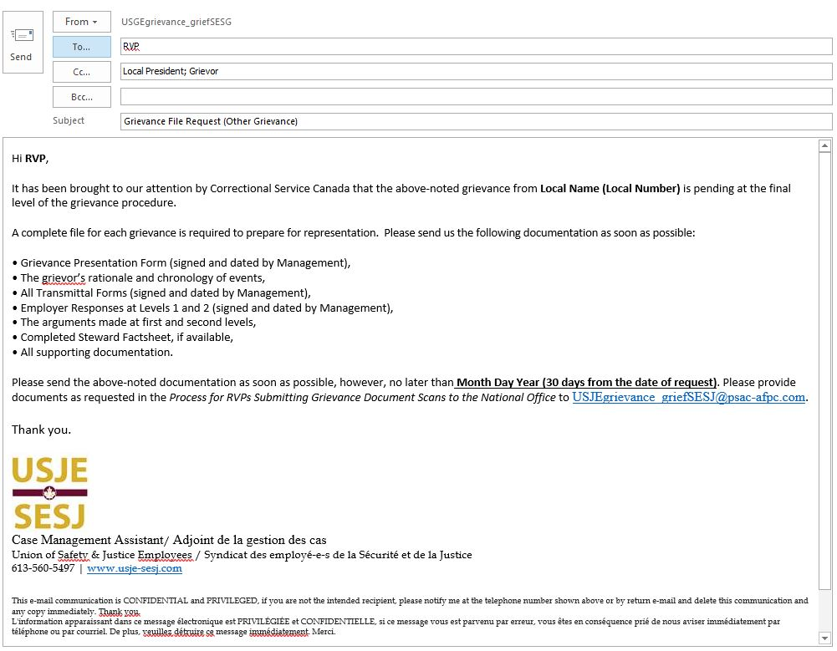
Notes:
This is an example of the request for most other types of grievances. If you receive a copy of a file request and you have not forwarded the complete file to your RVP, this is when you should do so.

Slide 22
Information Management
Complete Files/Forms

Slide 23
Complete Files/Forms
All forms must be signed and dated by all parties.
Transmittals for ALL levels must be included. If a level is skipped, documentation must be provided to show that both parties have agreed.
Termination grievances are the exception as they only require the Grievance Form and Transmittal to the third level.
Notes:
Our file requests are a good place to start if you are looking for a checklist of what a complete grievance file should contain. Please note that all forms must be signed and dated by all parties and transmittals for ALL levels must be included. If a level has been skipped, documentation must be provided to show that it was agreed upon by both parties. The only exception is for termination grievances, as they are transmitted directly to the third level, as such, a transmittal form must be completed and signed at the time of filing the grievance.

Slide 24
Membership
Notes:
Greetings everyone!

Slide 25
Information Management - Membership
Representation Information Form (Local Election Form)
  http://www.usje-sesj.com/en/representative-information-form-web
PSAC Portal
  https://psacunion.ca/user
PSAC Application for Membership Card
Membership Email
  USJEmembers_membresSESJ@psac-afpc.com
PSAC Source 2 Reports (Membership Lists)
Union Myths

Slide 26
Information Management
Representative Information Form (Local Election Form)

Slide 27
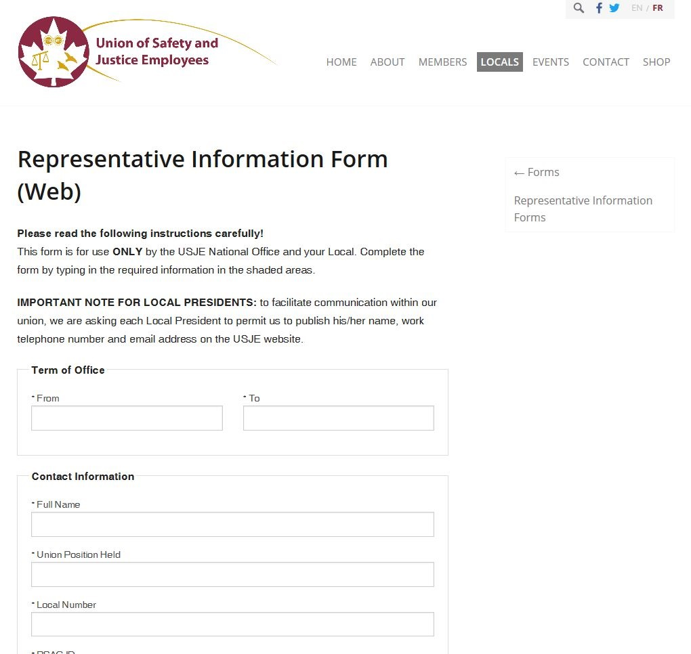
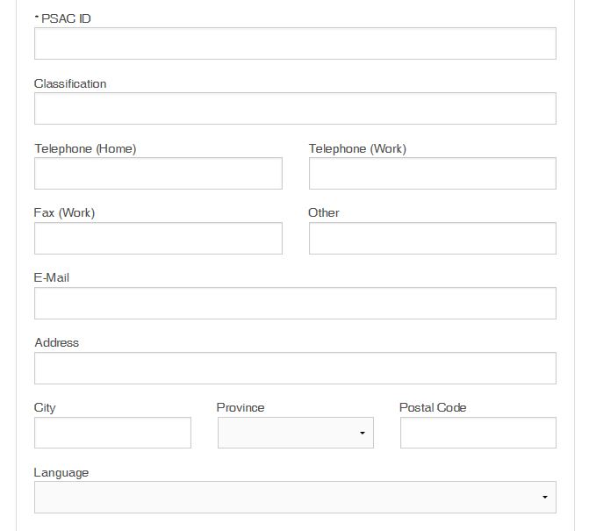
Notes:
This is a screen shot of a Representative Information Form (Local Election Form). The boxes highlighted in yellow indicate the information we require at the National Office in order to process the election form.
Important Note
The information (phone number, email address) you provide will be posted on USJE’s website. We recommend that you provide us with a personal email address, as your work email is on your employer’s server and is subject to ATIP.
Term of Office
It is important to enter the correct term of office in a YYYY-MM-DD format. All volunteers who have been elected to a local executive position at the same AGM should have the same start and end date as every other elected volunteer from the local.
http://www.usje-sesj.com/en/representative-information-form-web

Slide 28
Information Management
Update Member Information (PSAC Portal)

Slide 29
Update Member Information (PSAC Portal)
Updating contact Information
  Home Address
  Home phone number
  Work phone number
  Home email address
  Work email address
Notes:
We encourage all of our members to use the PSAC online portal. When a member updates their information via the PSAC online portal, the change is effective immediately and their member record in UnionWare is automatically updated.
Link: https://psacunion.ca/user

Slide 30
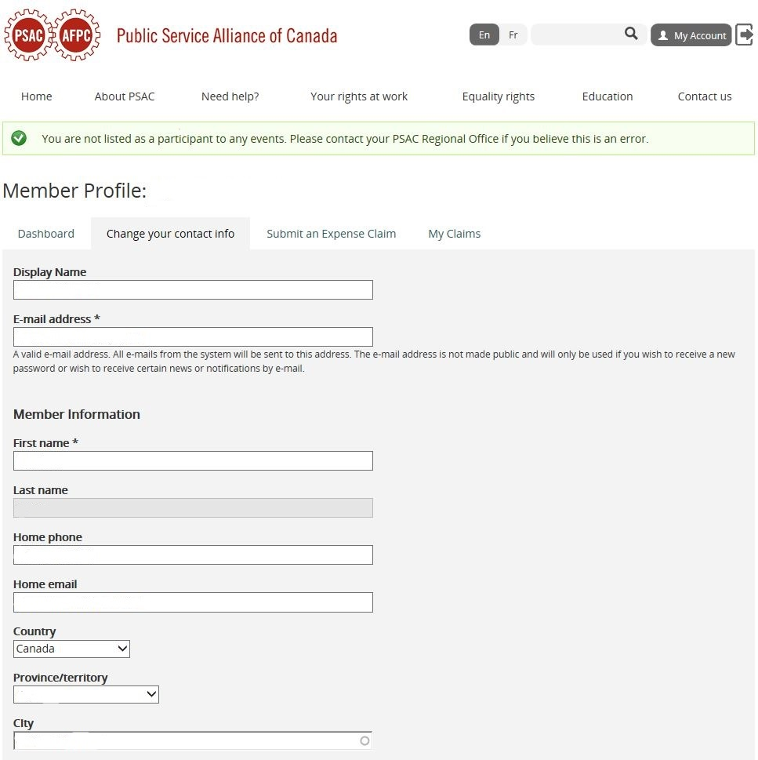
Notes:
PSAC Portal Screen where you will enter your contact information. If you have any issues creating your profile, please use the Contact Us page on PSAC’s website. If you need further help, contact your PSAC Regional Office for further assistance.

Slide 31
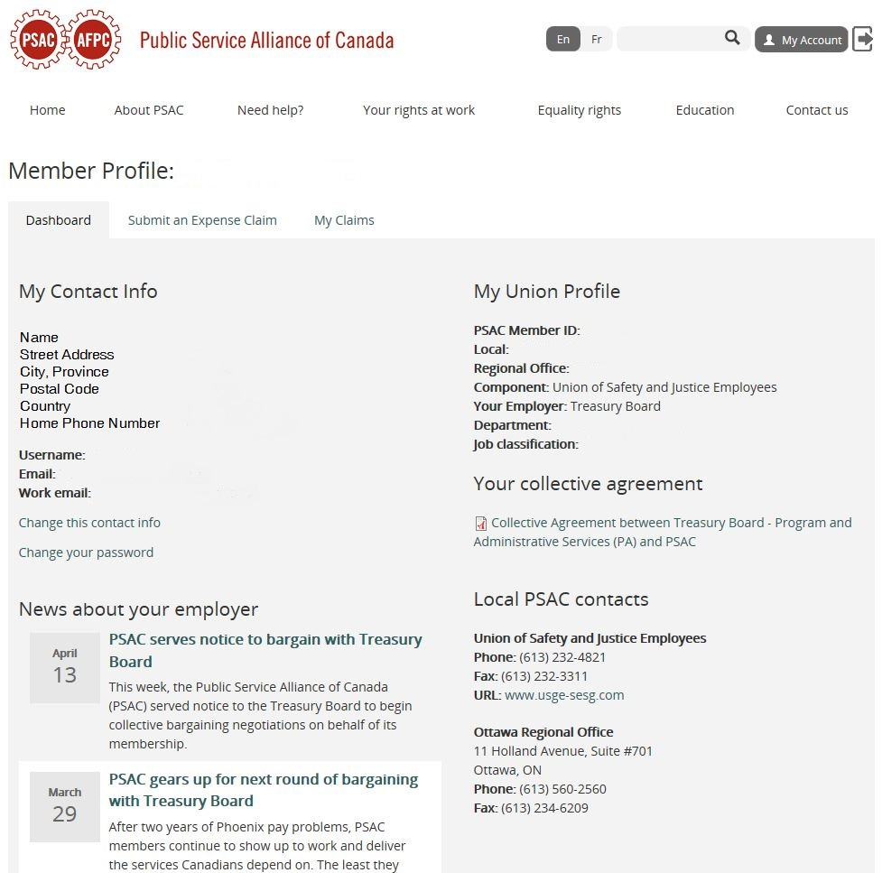
Notes:
Once your profile has been created and you can sign in to your PSAC member account, this is the PSAC portal home screen where you can preview your contact information, collective agreement, component, PSAC Regional Office and the news that affects you.

Slide 32
Information Management
Update Member Information (PSAC Application for Membership Card)

Slide 33
Update Member Information (PSAC Application for Membership Card)
Changing a member from RAND to Full
Updating contact information
Requesting a member local transfer
Requesting a new membership card
Notes:
PSAC Application for Membership cards are one of the most misunderstood tools in our union.
What happens when an Application for Membership card is signed and sent to the National Office?
I could ask all of you this question and get several different answers.
PSAC Application for Membership cards have one true purpose, to officially sign on a member to the PSAC union. The original signed cards are kept by PSAC, which is why we cannot accept scanned copies. Once we are in receipt of a signed card, the member’s status will be updated from RAND to Full and their contact information will be added to our database (UnionWare). This status change will also initiate the mailing of a membership card to the address that has been provided. In addition, the card allows us to verify a members local and/or allot them to one.

Slide 34
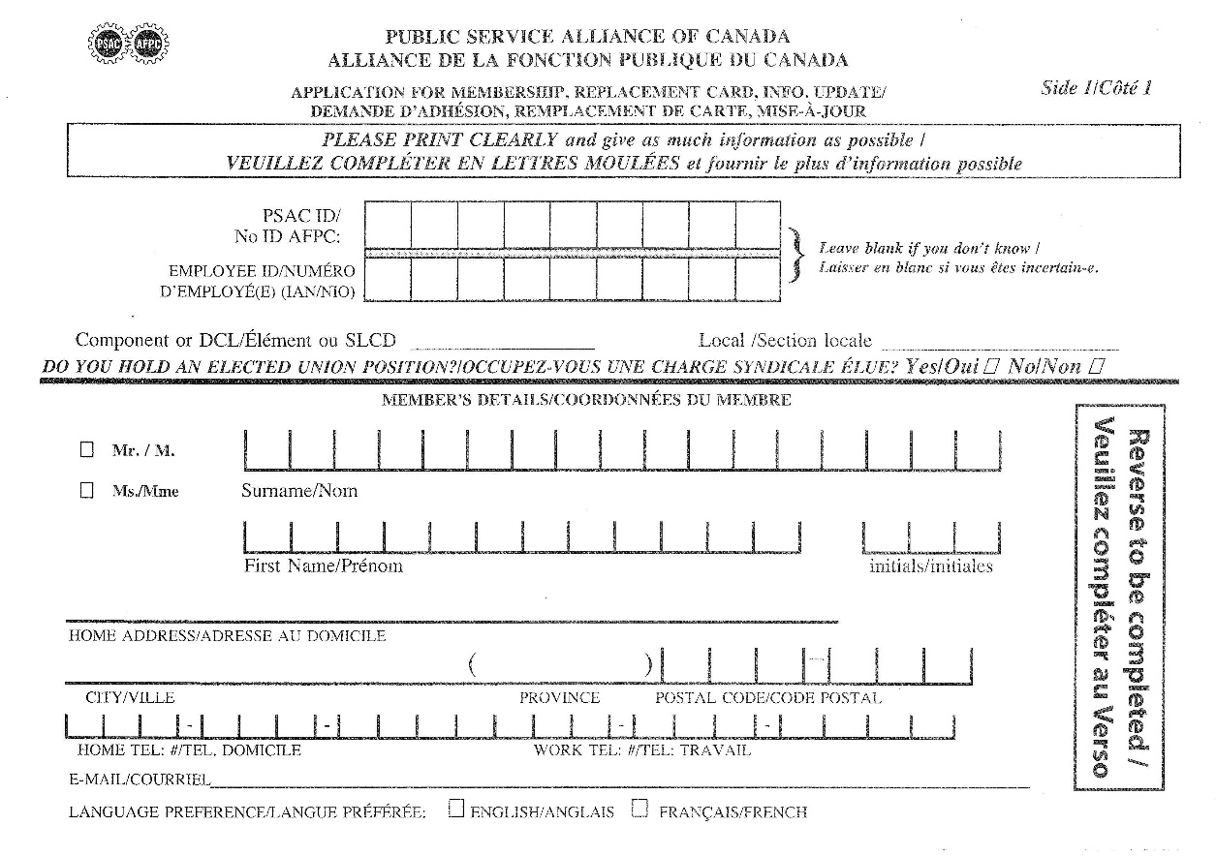
Notes:
This is a scanned copy of a PSAC Application for Membership card (Front).
The PSAC ID number is helpful (if you know it) as each number is unique and can be used to confirm a member’s identity. Often times, the members do not know their PSAC ID number, hence the reason why they are filling out a new membership card.
Component: USJE
Local: Your local number (i.e. 70125)
Contact Information: Please give us as much information as you are comfortable sharing.

Slide 35
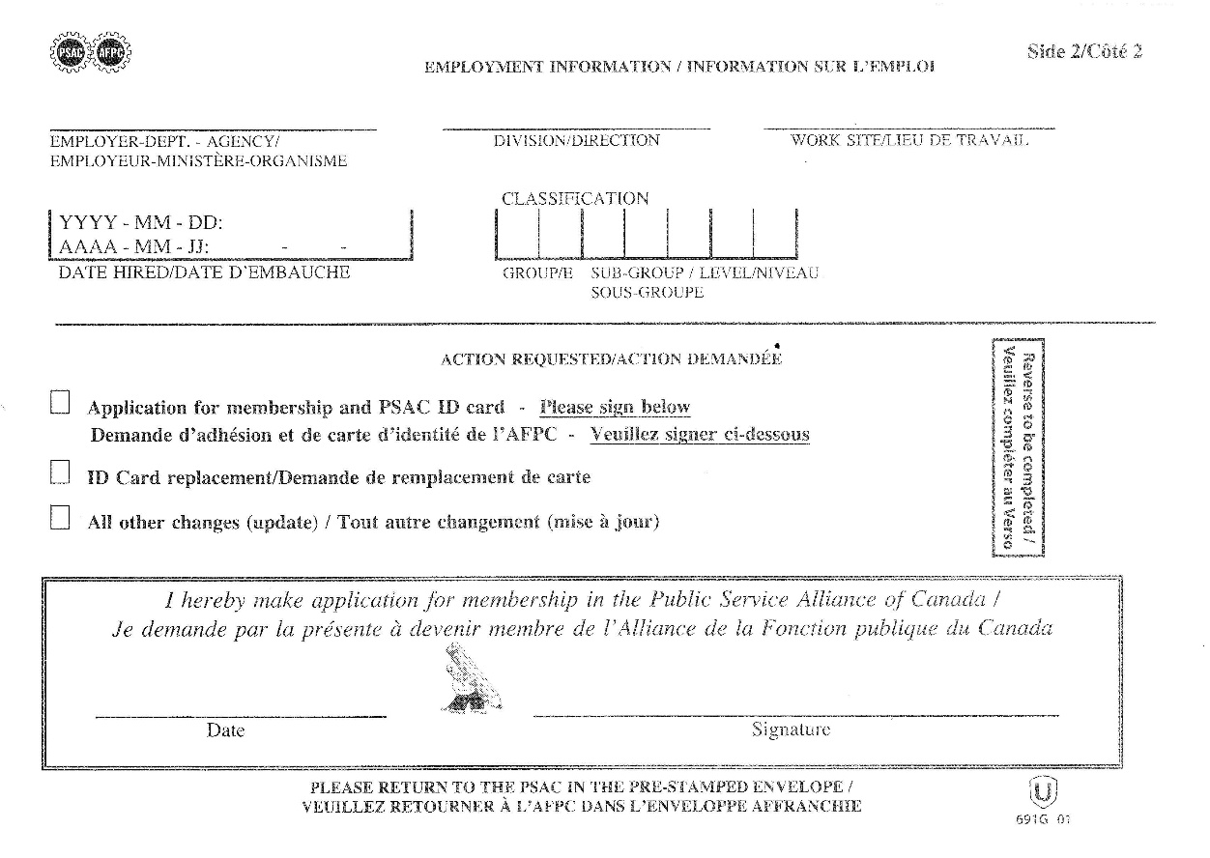
Notes:
This is a scanned copy of a PSAC Application for Membership card (Back).
The employer, work site, date of hire and classification information is not essential but is very useful when confirming the identity of a member. (i.e. there could very well be two individuals with the same first and last name that live in the same region.)

Slide 36
Information Management
Update Member Information (Membership Email)

Slide 37
Update Member Information (Membership Email)
Updating contact information
Requesting a member local transfer
Requesting a new membership card
Member is not paying dues despite being a long standing member
USJEmembers_membresSESJ@psac-afpc.com
Notes:
Updating Contact Information
Need to change one of your member’s contact information? We suggest having the member use the PSAC online portal, so that they can change their own information online, its fast and easy to use. If you or the member does not feel comfortable doing so, please send us an email with the contact information you wish for us to update/add to our database.
Requesting a member local transfer
Want to request a transfer for a member who was part of another local but is now in yours? Send us an email and we will be glad to help. We recommend you only action a member transfer, if the member is now in your local indeterminately or will be with you for three (3) months or more. If the member will only be in your local for a pre-determined amount of time let us know, that way, we can transfer them back to their original local once their term is over.
Requesting a new membership card
Do you have a member requesting a new membership card? Send us an email and we will request a card reprint and mail the new card to the member.
Member is not paying dues despite being a long standing member
If the member is not paying dues, this could be a Phoenix issue and they will need to submit a Pay Action Request (PAR) to the Pay Centre to have his/her dues started. The member should also submit a MIGS (Member in Good Standing) form via the PSAC website, to have his/her status protected.
https://www.tpsgc-pwgsc.gc.ca/remuneration-compensation/services-paye-pay-services/paye-centre-pay/demande-employee-request-eng.html
http://psacunion.ca/migs
Email: USJEmembers_membresSESJ@psac-afpc.com

Slide 38
Information Management
PSAC Source 2 Reports (Membership Lists)

Slide 39
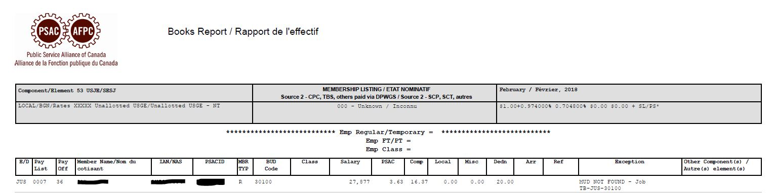
Notes:
Here is an example of a PSAC Source 2 Report (Members List) that your Treasurer and RVP receive monthly. If your local does not have a Treasurer, the report will be sent to the Local President, until such time as the Treasurer role is filled. Important information on the Source 2 Reports (Left to right, Top to bottom)
Component, Month/Year, Local, Member Name, PSAC ID, Member type R=RAND, F=Full Member & S=Suspended), PSAC dues taken, Component dues taken, Local dues taken, Miscellaneous dues, & Total deductions taken.

Slide 40
Information Management
Union Myths (Q&A)

Slide 41
Union Myths (Q&A)
If my member signs a membership card will they start paying dues?
Are members added to UnionWare by signing a membership card?
Do RAND members pay dues?
When should I request a member transfer from one local to another?
Notes:
If my member signs a membership card will they start paying dues?
No, a member starts paying dues when the employer identifies them as a member represented by a union. We cannot control when a member starts paying dues.
Are members added to UnionWare by signing a membership card?
No, as mentioned in my previous point, members are only added to our database once the employer identifies them as a represented employee.
Do RAND members pay dues?
Yes, the RAND status is used to identify members who have not yet signed a membership card.
When should I request a member transfer from one local to another?
We suggest requesting a transfer when a member is in an indeterminate or term position of three (3) months or longer.

Slide 42

Thank You!
You can contact us at
USJEmembers_membresSESJ@psac-afpc.com
USJEgrievance_griefSESJ@psac-afpc.com
Notes:
Your RVP is your first point of contact and their information can be found here:
http://www.usje-sesj.com/en/national-executive
Any question regarding our presentation can be directed here:
USJEmembers_membresSESJ@psac-afpc.com
USJEgrievance_griefSESJ@psac-afpc.com

Slide 43
Department of Finance and Administration

Slide 44
Department of Finance and Administration
NATIONAL PRESIDENT
Director
Mail Distribution Clerk/Receptionist
Administrative Assistant
Finance Officer

Slide 45
National Office Level
Finance
Accounts Payable
Accounts Receivable
Banking
Statements
Audit
Administration
Event planning
Contract negotiations
Human Resources
Office maintenance

Slide 46
Local Level
Finance
Rebates
Local financials
Salary/Honorarium
Administration
Review Bylaws
Issue LWP letters
General correspondence

Slide 47
Member Level
Finance
Expense claims
Administration
Communicate events
Arrange travel
Issue LWP letters

Slide 48
Contact Us!
You can email us at:
USJEFinanceSESJ@psac-afpc.com

Slide 49
Department of Policy, Projects and
Media Relations

Slide 50
Department of Policy, Projects and Media
Relations
NATIONAL PRESIDENT
Director
Senior Advisor to the Director
Strategic Communications Specialist
Researcher
Executive Assistant to the National President

Slide 51
Objectives
Our members are aware of USJE
Appreciate the services we provide
Become involved in their union
Key decision-makers know USJE and our work
Make decisions
Improve the professional and economic lives of our members

Slide 52
Policy
  Ensuring key decision-makers are aware of key issues for our USJE members through:
Meetings
Parliamentary committees
Opinion pieces
Research
Federal Budget Submission

Slide 53

Federal Budget Submission 2018
8

Slide 54
Key Topics for USJE
Harassment
Mental Health – Operational Stress Injuries
Engagement with Indigenous Members/Initiatives/Programs
Community Involvement

Slide 55
Programs
Communications
Ensuring our members are aware of USJE through:
Website
Social media
Videos
Direct messaging to members

Slide 56
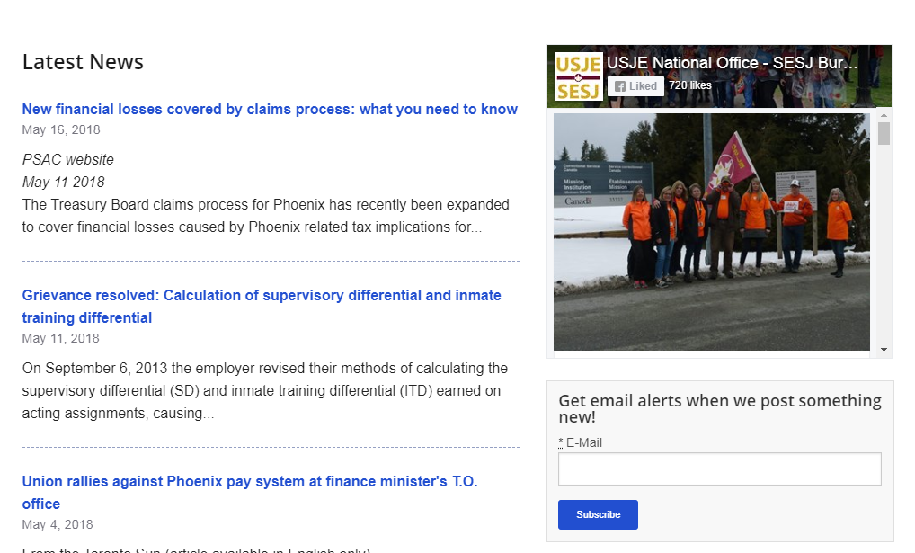

Sign up for alerts!
Sign up for alerts and write articles if you want to see them!
www.usje-sesj.com

Slide 57
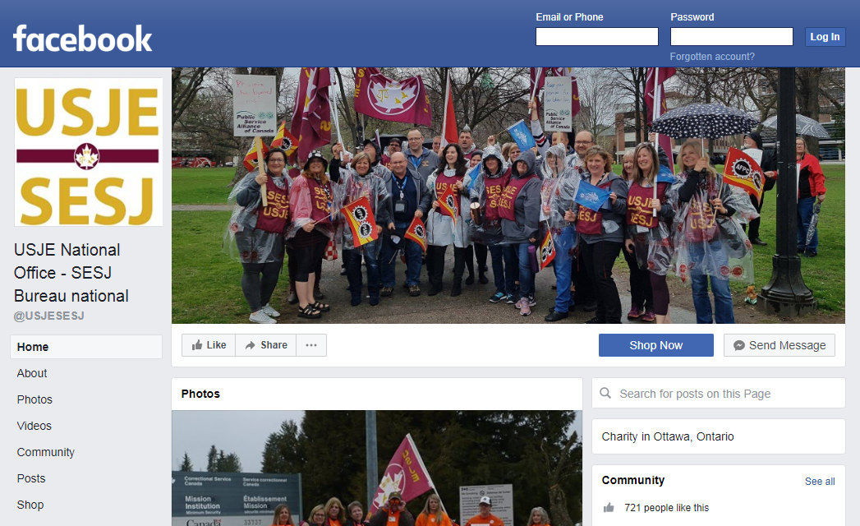
Like us on Facebook!
Find our page @ USJESESJ!
Share your USJE photos with us!

Slide 58
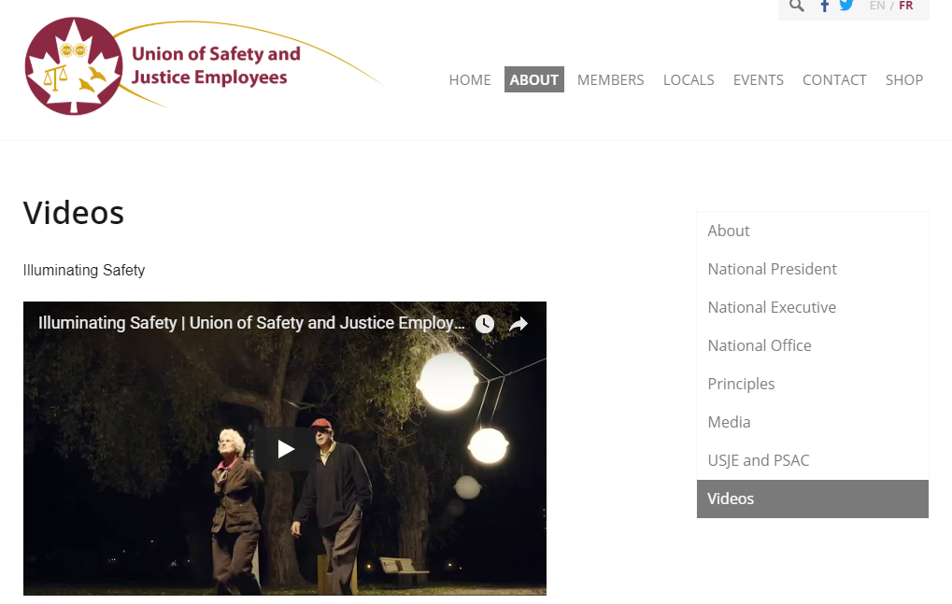
Award-winning videos
Illuminating Safety
Animated shorts
More coming soon!

Slide 59
Direct messages to members
USJE wins
Federal elections
Videos
Updates

Slide 60
Media
Proactive
Opinion pieces
Panel participation
Reactive
If you are approached, ask for a minute and contact your RVP!

Slide 61
More information required?
If you need more information:
Contact your RVP
Contact us: www.USJE-SESJ.com
If your RVP is not available:

